Slide 1

Impact of GGSTN properties and layers alternation
Simon Schmit, July 2025

Slide 2
IMPACT OF THE ABSORPTION COEFFICIENT
Configuration :
GGSTN first (45 nm)
1300W
1us pulse duration
350 um beam radius
GGSTN Absorption (1/m) | Maximum temperature (K) | Slope of temp vs depth (K/nm)
4.28E+05 | 1082.4 | -12.33
4.28E+06 | 1199.2 | -13.96
4.28E+07 | 1395.6 | -16.89

Slide 3
Impact of the Thermal Conductivity
Maximum temperature | GGSTN Thermal conductivity | Slope of GGSTN (temp vs depth) (K/nm)
976.61 | 0.2 | -11.55
828.44 | 0.28 | -8.25
717.53 | 0.4 | -5.78
1494.4 | 0.1 | -23.1
Configuration :
GGSTN first (45 nm)
1300W
1us pulse duration
350 um beam radius

Slide 4
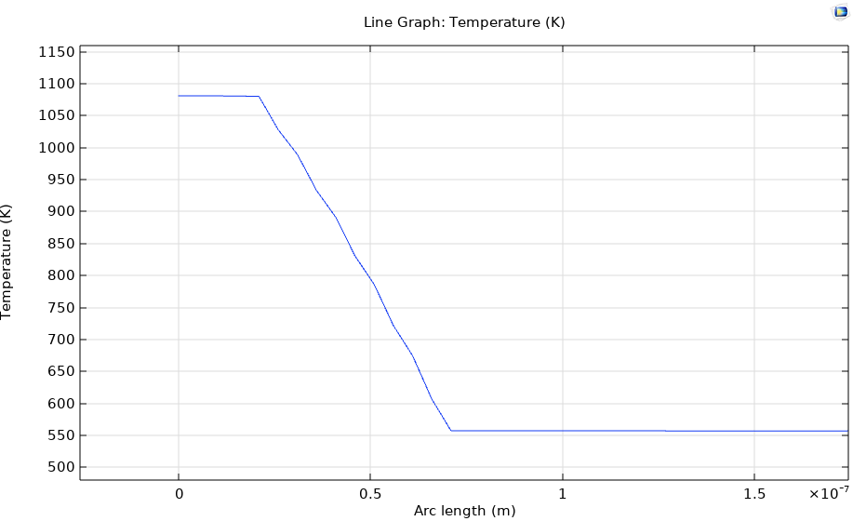
Layer alternation : temperature vs depth at t=1us
TiN (20 nm)
GST (5 nm)
GGSTN (5 nm)
50 nm
Si (substrate)
1700 um

Slide 5
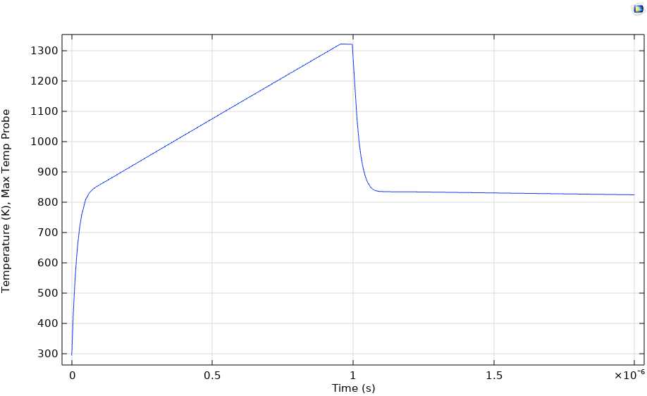
Layer alternation : temperature in the middle of the TiN surface
TiN (20 nm)
GST (5 nm)
GGSTN (5 nm)
50 nm
Si (substrate)
1700 um

Slide 6
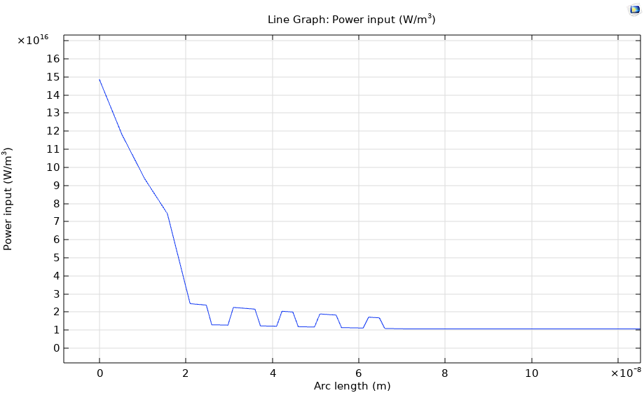
Layer alternation : heat input (W/m^3) vs depth at t=1us
TiN (20 nm)
GST (5 nm)
GGSTN (5 nm)
50 nm
Si (substrate)
1700 um

Slide 7
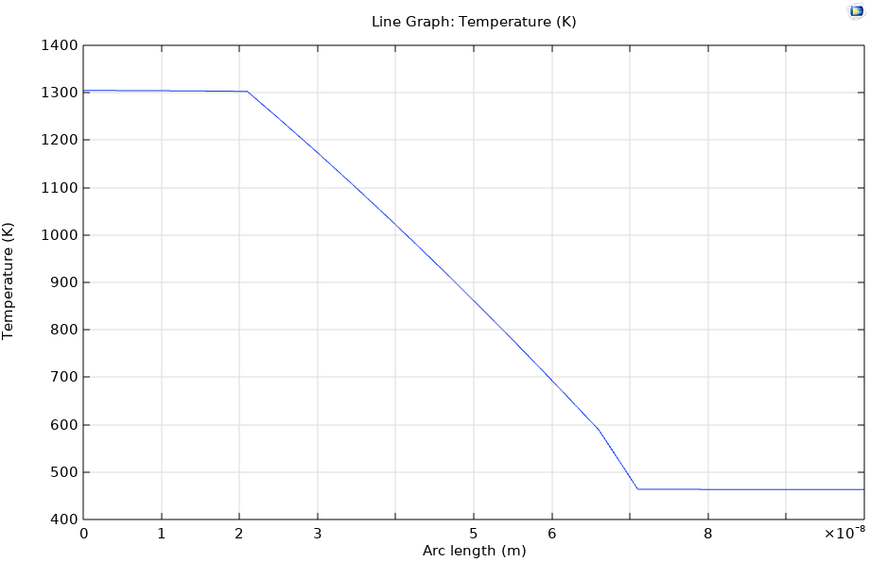
2500W Laser : classic configuration

Slide 8
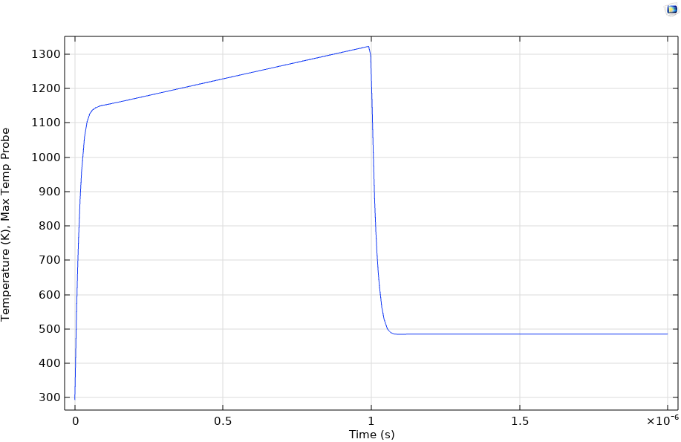
2500W Laser : classic configuration

